Slide 1
Architecture Considerations
Week 2: January 24, 2017
Professor: Steve Conrad

Slide 2
Query Languages
Structured Query Language (SQL)
  Two dimensional queries
  Vendor specific extensions
Multidimensional Expressions (MDX)
  based on the XML for Analysis (XMLA) specification and used to query multidimensional data (e.g. OLAP cubes)
  Some similarities to SQL
  Vendor specific extensions

Slide 3
Query Languages (cont.)
NoSQL
  Many types of databases (e.g Wide Column Store, Key Value Store, Document Store, Graph based) results in lower standardization.
  Many unique API’s and query methods
  Hadoop Languages – popular examples
    PIG
    Hbase
    Hive

Slide 4
SQL vs MDX
Comparisons made in class…
  Similarities
    Overall syntax similarity
    ….and functionality
  Differences
    Multi-dimension focus in where clause
    Hard to visualize structure of mdx due to multi-dimension with aliases

Slide 5
SQL vs NoSQL Database
Some key differences noted in class…
  Level of accuracy (NoSQL unstructured)
  SQL databases can be more difficult to scale
  NoSQL can become stale due to interpretation time.

Slide 6
Query Optimizations
Row store vs Column store
Row store Advantages
  Better performance when frequently querying/updating individual records - OLTP
  Accessing complete record and specific values (e.g. display contact information including name, address etc.)
Column store Advantages
  Better performance for analytical applications/aggregations
  Read access of a few columns and not the complete record
  Better compression rates and consequently can load more data for in-memory applications

Slide 7
Query Optimizations
In-memory
  Loads data into memory reducing I/O over traditional databases.
  Generally should be faster but the performance difference is dependent on various factors including hardware and the task.
  Vendors and even versions for the same vendor have different strengths and weaknesses such as the ability or inability to replicate transactions
Compression
  Can be applied to row store or column store environments
  Compression rates are generally higher for column store especially in data warehouse environments where there is more repeated values in a column.
  Can support faster queries in certain environments such as in-memory applications but can actually create lags when high compression is used for minimizing footprint size (e.g. archiving)

Slide 8
Massively Parallel Processing (MPP)
Massively Parallel Processing (MPP)
  “loosely-coupled” system
  Multiple processors each have their own O/S, memory (disks may or may not be shared)
  Interface used to coordinate and communicate processing of a single task
  Adding additional node produces near linear scalability
  Generally 50TB plus – most often data warehouse installations

Slide 9
Massively Parallel Processing (MPP) Convergence
MPP Appliances – hardware/software complete solution (e.g Microsoft Analytics Platform System (APS)/SQL Server Parallel Data Warehouse (PDW))
  Limited vendors – more expensive
  Growing integration with Hadoop (e.g. Microsoft HDInsight)
  Full vendor support available
Hadoop
  Deployed on commodity servers – less expensive
  Open source – need contracted/in-house expertise to build and maintain
Other MPP software (e.g Teradata, GreenPlum)
  A lot of variance between hardware/software configurations including open source and proprietary

Slide 10
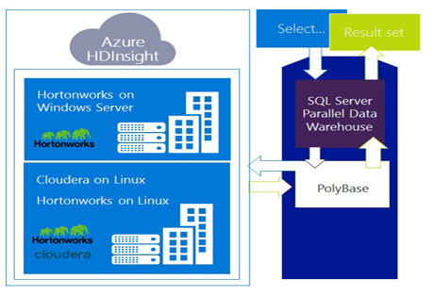
Microsoft APS Components
Source: https://www.microsoft.com/en-us/server-cloud/products/analytics-platform-system/overview.aspx

Slide 11
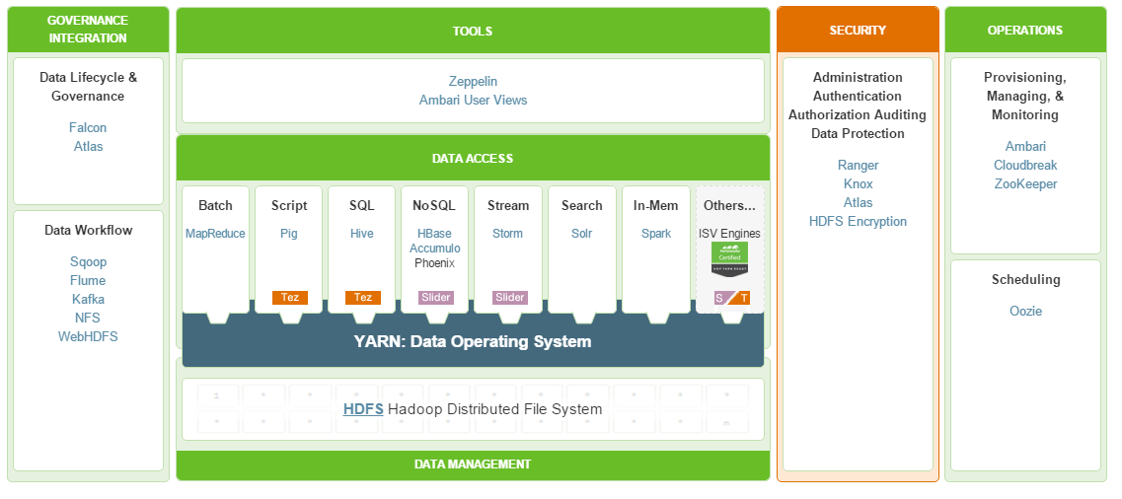
Hadoop Components and Utilities
Hortonworks Example
Source: Hortonworks - http://hortonworks.com/hdp/

Slide 12
The Cloud
Infrastructure as a Service (IAAS) - hardware and virtualization environment
  Servers and/or virtualization layers are created for you
  Example: Amazon Web Services (AWS), Google Compute Engine (GCE)
Platform as a Service (PAAS) – hardware, O/S and middleware
  You look after data/apps
  Example: Bluemix
Software as a Service (SAAS) – turnkey solution
  Often no or minimal customization
  Example: Office365, Google Apps

